Slide 1
NEAREST NEIGHBOR CLASSIFICATION

Slide 2
Instance-Based Classifiers
Set of Stored Cases
Store the training records
Use training records to
predict the class label of
unseen cases
Atr1 | ……... | AtrN | Class
 |  |  | A
 |  |  | B
 |  |  | B
 |  |  | C
 |  |  | A
 |  |  | C
 |  |  | B
Unseen Case
Atr1 | ……... | AtrN

Slide 3
Instance Based Classifiers
Examples:
Rote-learner
Memorizes entire training data and performs classification only if attributes of record match one of the training examples exactly
Nearest neighbor
Uses k “closest” points (nearest neighbors) for performing classification

Slide 4
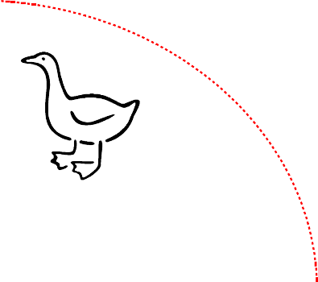
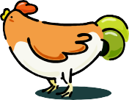



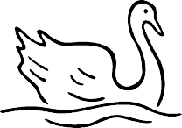
Nearest Neighbor Classifiers
Basic idea:
If it walks like a duck, quacks like a duck, then it’s probably a duck
Compute Distance
Test Record
Training Records
Choose k of the “nearest” records

Slide 5
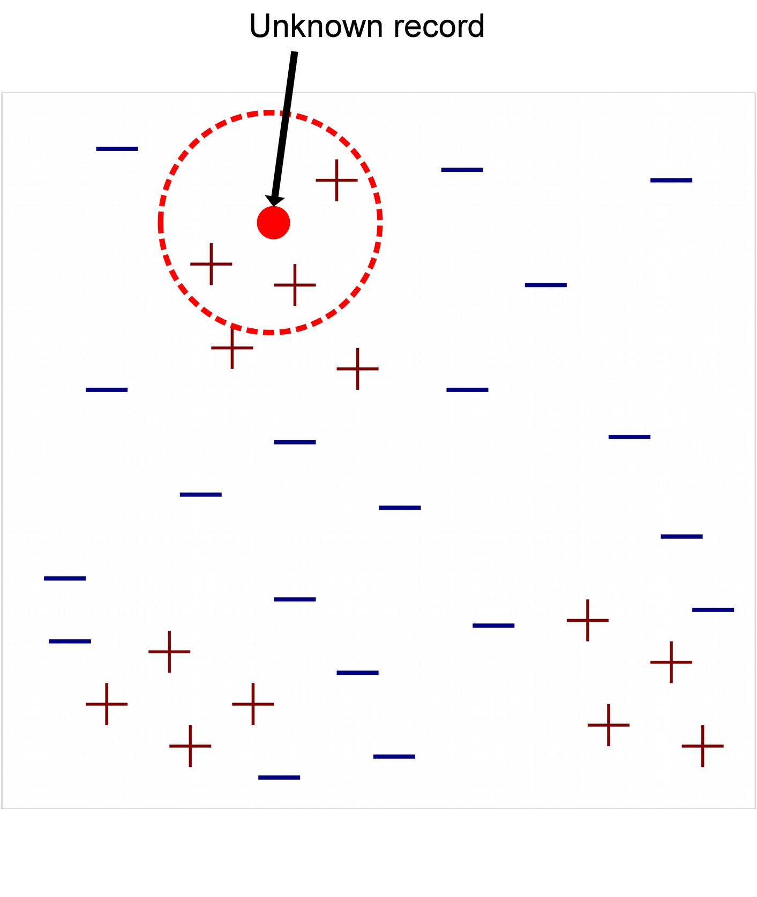
Nearest-Neighbor Classifiers
●
Requires three things
–
–
The set of stored records Distance Metric to compute distance between records The value of k, the number of nearest neighbors to retrieve
–
●
To classify an unknown record:
Compute distance to other training records
Identify k nearest neighbors
Use class labels of nearest neighbors to determine the class label of unknown record (e.g., by taking majority vote)

Slide 6

Definition of Nearest Neighbor
X
X
X
(a) 1-nearest neighbor (b) 2-nearest neighbor (c) 3-nearest neighbor
K-nearest neighbors of a record x are data points that have the k smallest distance to x

Slide 7
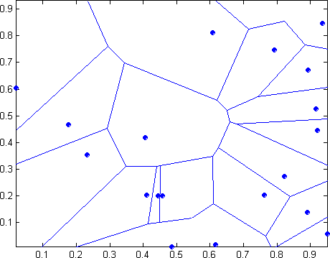

1 nearest-neighbor
Voronoi Diagram defines the classification boundary
The area takes the class of the green point

Slide 8
Nearest Neighbor Classification
Compute distance between two points:
Euclidean distance
d ( p, q) = ∑ ( p − q )
2
i
i i
Determine the class from nearest neighbor list
take the majority vote of class labels among the k- nearest neighbors
Weigh the vote according to distance
weight factor, w = 1/d²

Slide 9
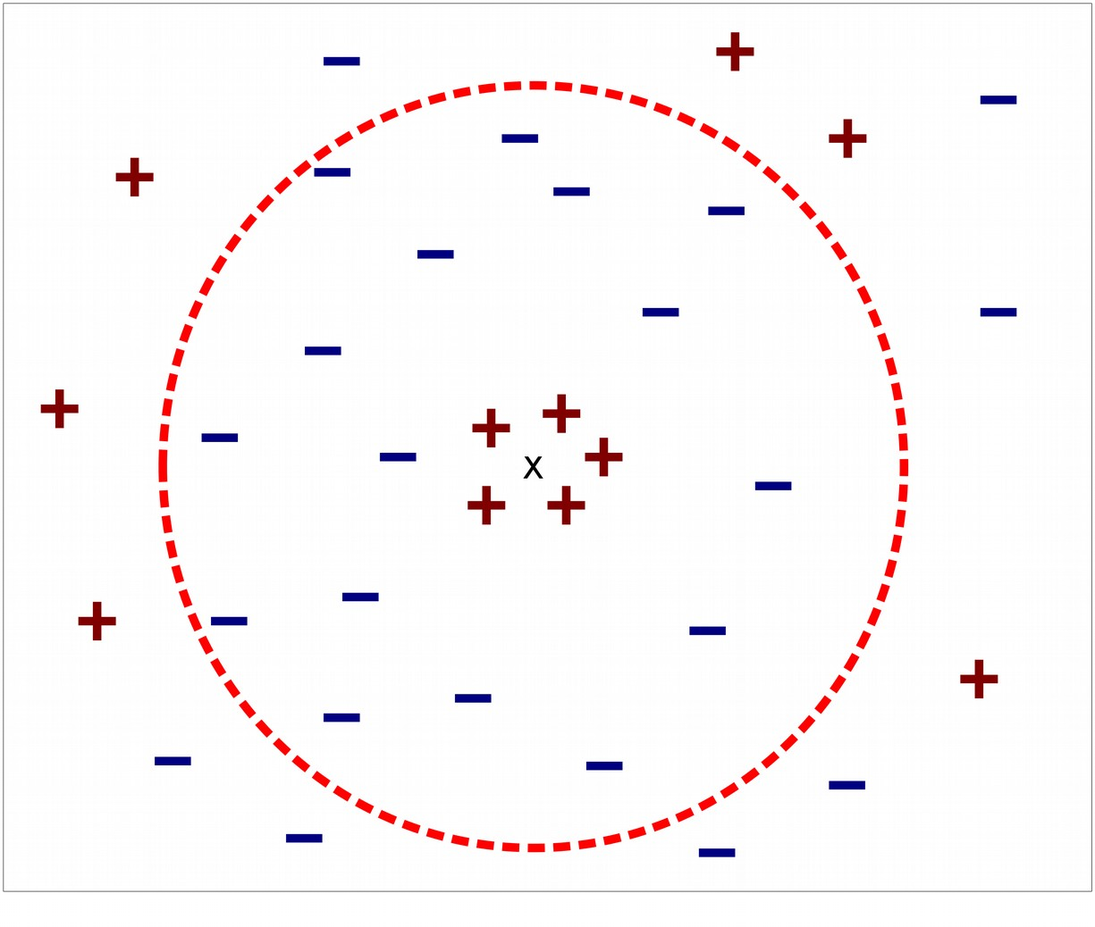
Nearest Neighbor Classification…
Choosing the value of k:
If k is too small, sensitive to noise points
If k is too large, neighborhood may include points from other classes

Slide 10
Nearest Neighbor Classification…
Scaling issues
Attributes may have to be scaled to prevent distance measures from being dominated by one of the attributes
Example:
•
•
•
height of a person may vary from 1.5m to 1.8m weight of a person may vary from 90lb to 300lb income of a person may vary from $10K to $1M

Slide 11
Nearest Neighbor Classification…
Problem with Euclidean measure:
High dimensional data
curse of dimensionality
Can produce counter-intuitive results
1 1 1 1 1 1 1 1 1 1 1 0
1 0 0 0 0 0 0 0 0 0 0 0
vs
0 1 1 1 1 1 1 1 1 1 1 1
0 0 0 0 0 0 0 0 0 0 0 1
d = 1.4142 d = 1.4142
^{υ} Solution: Normalize the vectors to unit length

Slide 12
THANK YOU !!!

